Slide 1

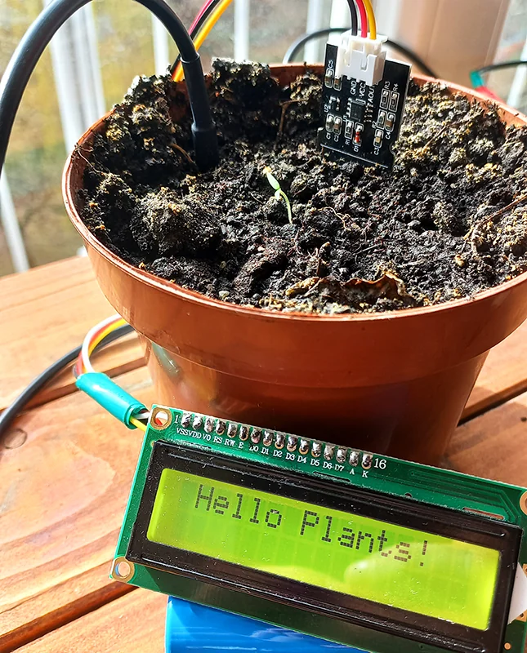
MPMC Project 2024
TITLE:
SMART IRRIGATION SYSTEMS
DIVYANSHU SINGH

Slide 2
BACKGROUND/ORIGIN/ROAD MAP
BACKGROUND/ORIGIN
Rise of Smart Irrigation Systems
Global Water Scarcity in Agriculture
Combines IoT, sensors, and automation.
Enables efficient, need-based water distribution, reducing water wastage, and enhancing crop yields.
Agriculture uses ~70% of freshwater resources.
Inefficient water use leads to economic and environmental challenges.
Limitations of Traditional Irrigation
High water wastage, manual operation, and limited adaptability to crop needs.

Slide 3
BACKGROUND/ORIGIN/ROAD MAP
ROAD MAP
Project Structure
Literature Review: Overview of recent advancements in smart irrigation.
Current Scenario: Adoption of smart systems globally and locally.
Methodology: System components (e.g., sensors, controllers) and working principle.
Results & Analysis: Expected improvements in water use.
Future Enhancements: AI integration, data analytics, and weather-based controls.
Objectives
Minimize water wastage, maximize irrigation efficiency, and boost crop productivity.

Slide 4
INTRODUCTION
Growing Need for Water Efficiency: Increasing water scarcity and the demand for sustainable agricultural practices have highlighted the need for efficient irrigation methods to conserve resources.
Purpose of Smart Irrigation Systems: Smart irrigation systems use advanced sensors and IoT technology to monitor soil moisture, weather, and crop needs, ensuring that water is applied precisely and efficiently.
Enhanced Crop Management: By delivering water only when needed, these systems play a crucial role in optimizing crop growth, reducing water wastage, and improving yield.
Automated and Remote-Controlled Operation: Smart irrigation systems provide automation and remote control options via mobile applications, allowing farmers to monitor and manage irrigation from anywhere, increasing convenience and control.

Slide 5

Literature (ACS/ Nature/ Wiley/ IEEE Journals)
IEEE Journals
• IoT-Based Smart Irrigation for Water Management: Integrates IoT and sensors to monitor soil moisture and crop needs, enhancing water efficiency.
• Machine Learning & IoT in Precision Agriculture: Uses predictive models to optimize watering, reducing waste.
ACS Journals
• Low-Cost Soil Moisture Sensors: Advances in affordable sensors improve soil moisture accuracy.
• Smart Fertigation Systems: IoT-driven nutrient delivery reduces both water and fertilizer waste.
Wiley Journals
• Smart Irrigation & Sensor Networks: Reviews wireless sensor networks and IoT for better water usage.
• Water-Efficient Agriculture: Highlights IoT automation using data from soil, weather, and crops.
Nature Journals
•Precision IoT in Agriculture: Discusses IoT-based precision techniques for sustainable water control.
•Soil Sensing & Data Analytics: Latest tech in soil sensors supports sustainable water use.
These studies showcase advancements in IoT, sensors, and data analytics, offering pathways for efficient, sustainable irrigation
Supercomputers

Slide 6


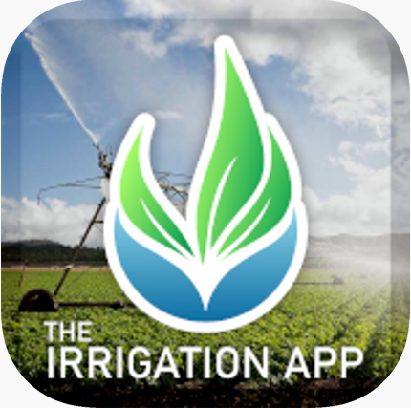
CURRENT SCENARIO
Smart irrigation systems are transforming modern agriculture by enabling efficient water use through IoT technology, data analytics, and sensor networks. These systems monitor soil moisture, weather, and crop needs in real-time, allowing farmers to water crops precisely as needed. The integration of AI and machine learning further enhances decision-making, predicting optimal irrigation times to reduce water waste. With smartphone connectivity, farmers can control irrigation remotely, increasing convenience and adoption. Supported by government incentives, smart irrigation promotes sustainable water management, lowers costs, and improves crop yields, making it a crucial tool for addressing water scarcity and boosting agricultural productivity.

Slide 7

Methodology, Working principle/ scientific reason
METHODOLOGY
Components:
Sensors: Soil moisture sensors, temperature sensors, and humidity sensors gather real-time data from the field.
Microcontroller/Processor: An Arduino or ESP8266 microcontroller receives data from sensors and acts as the system’s brain, making decisions based on pre-set conditions.
Communication Module: A GSM or Wi-Fi module transmits data to a smartphone or cloud, allowing remote monitoring and control.
Actuator: Connected to a water pump or valve to control water flow based on sensor readings.
Process Flow:
Data Collection: Sensors measure soil moisture and environmental parameters.
Decision Making: The microcontroller processes sensor data; if moisture is below the threshold, the controller activates the pump.
Control Action: The actuator turns on the pump, providing water until the moisture reaches the desired level.
Notification and Monitoring: System updates are sent to a mobile app or cloud, enabling remote access and monitoring by the user.

Slide 8
Methodology, Working principle/ scientific reason
WORKING PRINCIPLE/SCIENTIFIC REASON
Soil Moisture Detection:
Mechanism: Soil moisture sensors measure water content.
Scientific Reason: Ensures plants receive optimal moisture, preventing stress.
2.Microcontroller Decision-Making:
Mechanism: The microcontroller processes sensor data.
Scientific Reason: Automates irrigation decisions, minimizing human error and adapting to environmental changes.
3.Activation of Irrigation:
Mechanism: The actuator (pump/valve) is activated when moisture is low.
Scientific Reason: Aligns with precision agriculture principles, supplying water exactly when needed.
4.Remote Monitoring and Control:
Mechanism: GSM/Wi-Fi modules send real-time alerts to smartphones.
Scientific Reason: Allows for immediate adjustments based on current conditions, enhancing flexibility.
5.Water Conservation:
Mechanism: Irrigation occurs only when necessary.
Scientific Reason: Reduces water wastage, promoting sustainable agricultural practices.

Slide 9
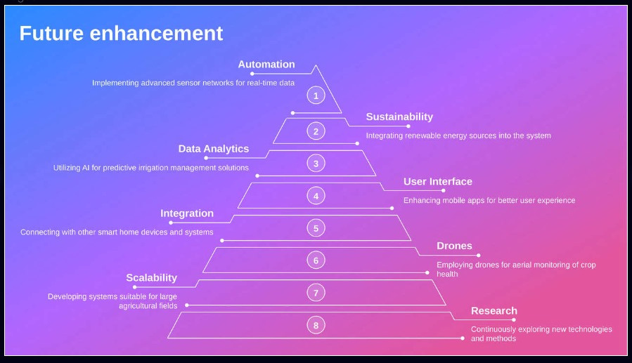

Slide 10
Thank you

